Slide 1

Shri Vaishnav Institute of Management & Science, Indore
Department of Computer Science
Major Project : MCA 404
(2023 –2025)
RideSwift: A Smart Ride-Sharing Platform
Presented by:
DEEPANSHU RATHORE
(0807CA231024)

Slide 2
RideSwift: A Smart Ride-Sharing Platform
Contents
Overview
Project
Problem Investigation
  Goal & Objectives of the Project
  Feasibility Analysis
  Solution Suggested
System Analysis
  Introduction to Proposed System
  Information Gathering
  Process Model Used
  Process Chart
  Data Flow Diagram & Data Dictionary

Slide 3
RideSwift: A Smart Ride-Sharing Platform
Contents
Project Planning
  Project Resources
  Team Organization
  Schedule
System Design
  Design Methodology
  Database Design
  Forms and Report Design
  Test Case Design (Manual / Automated)
Tools Used
  Front End and Back End

Slide 4
RideSwift: A Smart Ride-Sharing Platform
Contents
Testing
Implementation
  Administrative Functions
  User Functions
  Screen layouts
    Forms Layouts
    Report Layouts
Conclusions
Bibliography

Slide 5
RideSwift: A Smart Ride-Sharing Platform
Introduction
RideSwift is a user-friendly ride-sharing web application designed to simplify urban travel by connecting passengers with nearby drivers. Built using the MERN stack (MongoDB, Express.js, React.js, and Node.js), RideSwift offers an intuitive and visually appealing interface for both riders and drivers. Key features include real-time ride booking based on location and destination, transparent fare estimates, driver tracking, secure online payments, and user registration for a personalized experience. Drivers benefit from a comprehensive admin dashboard to manage ride requests, earnings, and availability. In essence, RideSwift streamlines the ride-booking process for both commuters and drivers, offering a reliable and efficient transportation alternative.

Slide 6
RideSwift: A Smart Ride-Sharing Platform
Problem Investigation
RideSwift aims to create an efficient platform to bridge the gap between drivers and passengers in a city environment, ensuring comfort, reliability, and affordability.
.
Objectives
• To enable real-time ride booking with live driver location.
• To simplify urban transportation with a centralized ride-sharing system.
• To enhance user experience with fare transparency and feedback system.
• To provide admins and drivers with a powerful management panel.
• To reduce waiting time for passengers.

Slide 7
RideSwift: A Smart Ride-Sharing Platform
Problem Investigation
Feasibility Analysis
Feasibility analysis is a test of system proposal regarding its work ability, and ability to meet user need, effective use of resources. Thus when a new application is proposed it normally goes through a feasibility analysis before it is approved for deployment.

Slide 8
RideSwift: A Smart Ride-Sharing Platform
Problem Investigation
Feasibility Analysis
Here's a step-by-step guide to conducting a feasibility study for Tourify project:
Technical Feasibility: This system is technically feasible because React.js used as a frontend and also used MongoDB as a backend because it is an open source tools.
Economic Feasibility: I am developing the website at the learning stage so it is difficult to determine the cost of the system and to decide that the project is economical feasible or not.
Operational Feasibility: All operations are feasible and user friendly. All operations are easy for achievable. The proposed system satisfies the admin and customer's needs. The interface is extremely user friendly.

Slide 9
RideSwift: A Smart Ride-Sharing Platform
Problem Investigation
Solution Suggested
Develop a fast and responsive web application for booking and ride tracking.
Ensure secure logins and session handling for riders and drivers.
Build a centralized system for fare estimates, ride requests, and driver allocation

Slide 10
RideSwift: A Smart Ride-Sharing Platform
System Analysis
System analysis is a problem-solving technique that breaks down a system into its component parts in order to evaluate how well those components perform and interact to achieve their goals.
Introduction to proposed system
RideSwift is a user-friendly ride-sharing web application designed to simplify urban travel by connecting passengers with nearby drivers. Built using the MERN stack (MongoDB, Express.js, React.js, and Node.js), RideSwift offers an intuitive and visually appealing interface for both riders and drivers. Key features include real-time ride booking based on location and destination, transparent fare estimates, driver tracking, secure online payments, and user registration for a personalized experience. Drivers benefit from a comprehensive admin dashboard to manage ride requests, earnings, and availability. In essence, RideSwift streamlines the ride-booking process for both commuters and drivers, offering a reliable and efficient transportation alternative.

Slide 11
RideSwift: A Smart Ride-Sharing Platform
System Analysis
System analysis is a problem-solving technique that breaks down a system into its component parts in order to evaluate how well those components perform and interact to achieve their goals.
Information Gathering
During this information gathering phase, I have collected valuable insights and knowledge about the RideSwift from various online resources, including websites, blogs, forums, YouTube tutorials, as well as sought guidance from project guide. This information served as a foundation for the successful development of this project.

Slide 12
RideSwift: A Smart Ride-Sharing Platform
System Analysis
System analysis is a problem-solving technique that breaks down a system into its component parts in order to evaluate how well those components perform and interact to achieve their goals.
Process model used
To develop a system there is a requirement of process model. It defines a process for each phase and check the status of this system. According to the need of proposed system the spiral model is best suited for it.

Slide 13
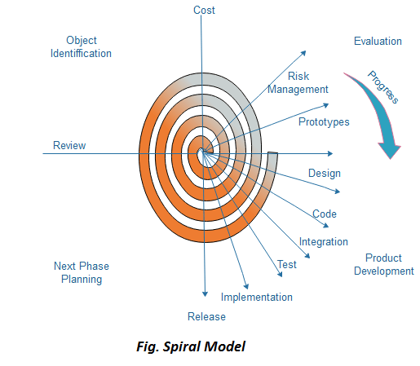
RideSwift: A Smart Ride-Sharing Platform
System Analysis
Process model used

Slide 14
RideSwift: A Smart Ride-Sharing Platform
System Analysis
Process chart
Ride Booking
User/Captain login/register
Check user availability in DB
Caption see all rides
Redirect to user-dashboard to create ride ,search
Caption confirms booking
Fill details and book Ride
User does payment
Payment gateway

Slide 15
RideSwift: A Smart Ride-Sharing Platform
System Analysis
Data flow diagram
View View
Response Response
RideSwift
Captain
Users
Figure : 0-level DFD

Slide 16
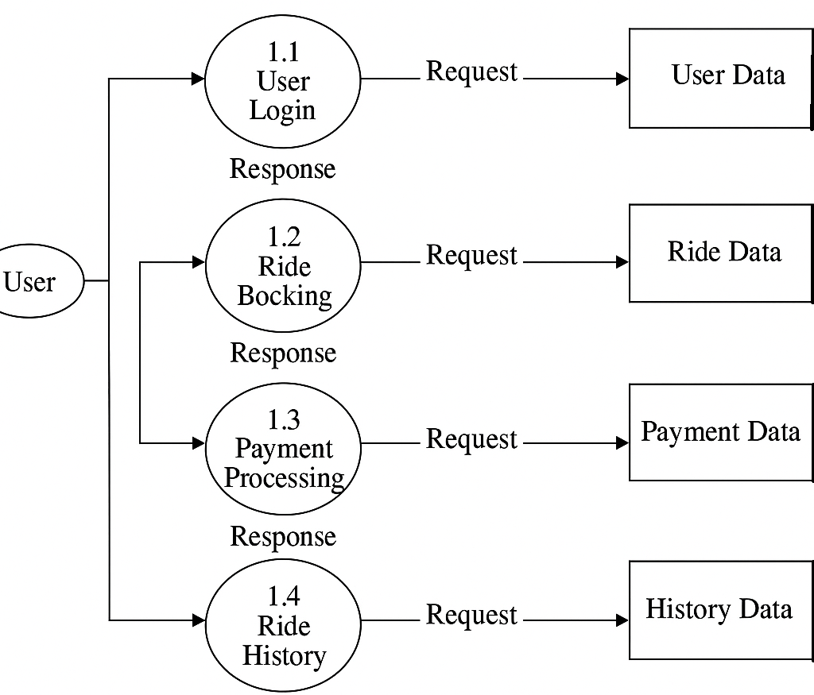
RideSwift: A Smart Ride-Sharing Platform
System Analysis
Data flow diagram
Figure : 1-level DFD

Slide 17
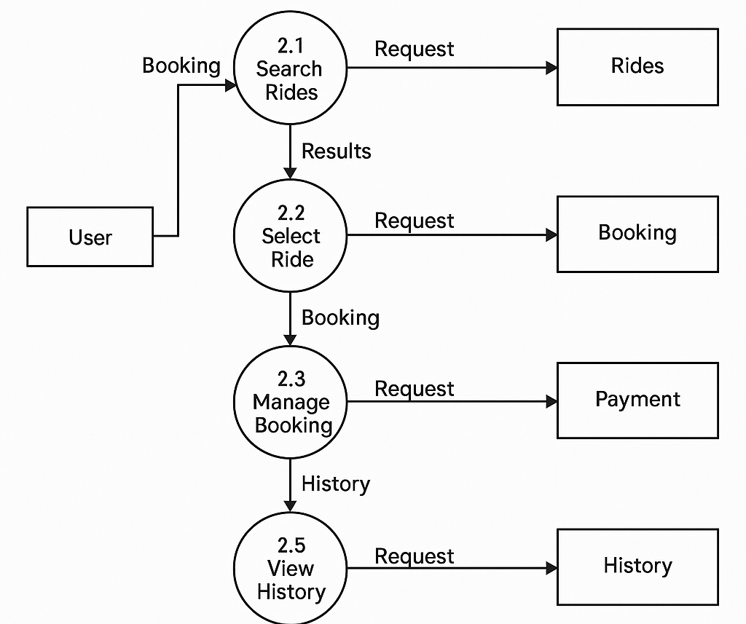
RideSwift: A Smart Ride-Sharing Platform
System Analysis
Data flow diagram
Figure : 2-level DFD

Slide 18
RideSwift: A Smart Ride-Sharing Platform
System Analysis
Data Dictionary
User login
Name : user login to Rideswift system
Description : User creates account an login the app
Input : Email id of a user and password .
Output : Displays success or error message
Data structure : Data structure used to store the user data.
Schema- (_id, email, password,role), where _id is primary key.

Slide 19
RideSwift: A Smart Ride-Sharing Platform
System Analysis
Data Dictionary
ii. Booking
Name : User ride creation and booking system
Description : User fills out the details to create a ride or book a ride
Input : Enter source, destination, date, and number of passengers.
Output : Redirects to ride matching or captain confirmation
Data structure : Data structure used to store the user data.
Schema-(userId,userEmail, source,destination,vehicleType,VehNo)
where _id is primary key.

Slide 20
RideSwift: A Smart Ride-Sharing Platform
Project Resources
Hardware Requirements :
Project Planning
Component | Specification
Processor | Inter 3/Ryzen 3
RAM | 4GB
HDD | 1TB
SSD | 256GB

Slide 21
RideSwift: A Smart Ride-Sharing Platform
Project Resources
Software Requirements :
Project Planning
component | Specification
Operating system | Windows 10/ 11
Language | HTML, CSS, JavaScript
Database | MongoDB
Browser | Mozila , Firefox, Opera, Chrome
Software Development Kit | VS code
Scripting Language Enable | Node.js

Slide 22
RideSwift: A Smart Ride-Sharing Platform
Team Organization
Team organization of the project consist one member.
Project Planning
Name | Contact number | Email id
Deepanshu Rathore | 9755514428 | deepanshurathore975@gmail.com

Slide 23
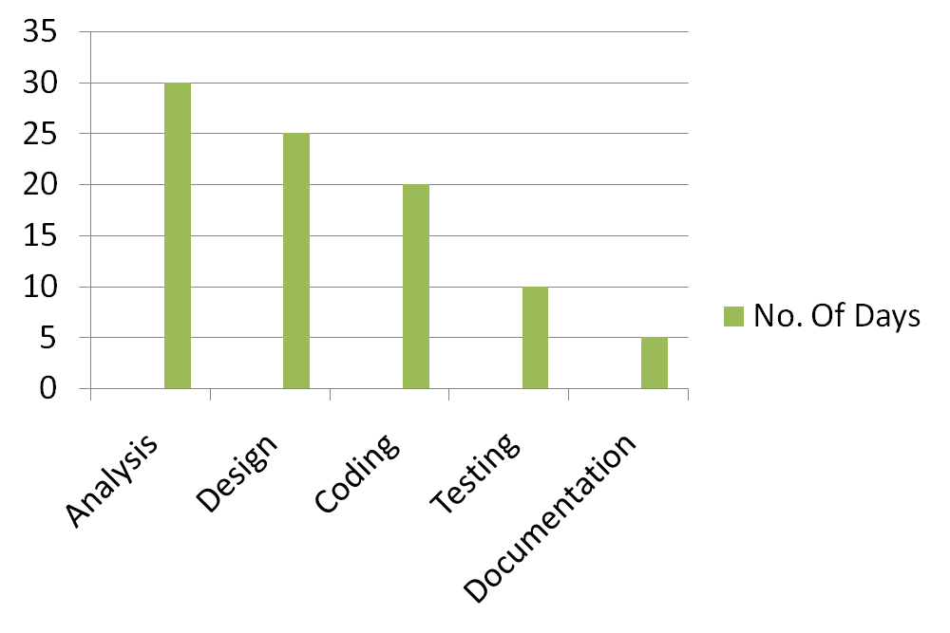
RideSwift: A Smart Ride-Sharing Platform
Schedule
Project Planning

Slide 24
RideSwift: A Smart Ride-Sharing Platform
Design methodology
UML
a. Use Case Diagram
b. Activity Diagram
c. Class Diagram
d. Sequence Diagram
System Design

Slide 25
RideSwift: A Smart Ride-Sharing Platform
Use Case Diagram
login
See details
Search Ride
Book Ride
Admin
Accept Ride
User
Payment
Manage Ride
logout

Slide 26
RideSwift: A Smart Ride-Sharing Platform
Activity Diagram
Visit website
Browse route
Select destination
Create Ride
Select vehicle
Login ?
yes
Waiting for accept
No
login
Captain Accept
User Receive response
Confirm booking

Slide 27
RideSwift: A Smart Ride-Sharing Platform
Class Diagram
System Design
User
Ride
Booking
+Id : String
+username : String
+password: String
+Id : String
+title: String
+city: String
+address: String
+price: Number
+Id : String
+userEmail: String
+tourName: String
+fullName: String
+phone: Number
+guestSize: Number
+Login()
+Logout()
+Register()
+SearchRide()
+createRide()
Payment
Review
+Id : String
+cardNumber: Number
+cvv :String
+payDate: Date
+Id : String
+username: String
+reviewText: String
+rating: Number
+PayMethod()
+reviewTour()

Slide 28
RideSwift: A Smart Ride-Sharing Platform
System Design
Sequence Diagram
Ride
Ride Description
Book Ride
Payment
Search
Select Ride
Read description
fillup detail
Confirm booking
Pay
Fill card detail
Ride Confirmed

Slide 29
id
password
username
rating
Email
Password
email
1:1
Verify
Give
Login
User
Review
1:1
1:N
1:N
Verify
reviewText
id
1:N
Search
id
email
Ride
Does
username
Admin
source
id
password
has
Booking
vehicle
destination
Payment
Price
vehicletype
source
cvvNumber
id
otp
Destination
cardNumber

Slide 30
RideSwift: A Smart Ride-Sharing Platform
System Design
Test Case Design (Manual / Automated)
Test Case No. | User Action (Button) | Expected Result | Observed Output | Result
1 | Enter Correct Email and Password | Webpage should navigate to home page of website | When entered email and password, home page appears. | Pass
2 | Enter Incorrect Email and Password | The user can’t book ride | When entered email and password it asked again to enter correct email and password | Pass
3 | User search for ride | Result should be appear according to search action | When user search tour, the result appear | Pass
4 | User select a ride and proceed booking | Tour should be book. | Ride Booked | Pass
5 | Enter card detail | Payment should be done. | Payment done | Pass

Slide 31
RideSwift: A Smart Ride-Sharing Platform
Frontend
HTML : used to create structure of the website.
CSS : Cascading Style Sheets is a style sheet language used for specifying the presentation and styling of a document written in a markup language such as HTML.
JavaScript : JavaScript is used to add functionality to the website.
React.js : React.js is a JavaScript library for building user interfaces.
Bootstrap : Bootstrap is a popular front-end framework for building responsive and visually appealing websites and web applications using HTML, CSS, and JavaScript components.
Tools Used

Slide 32
RideSwift: A Smart Ride-Sharing Platform
Backend
Node.js: Node.js is a runtime environment that allows you to execute JavaScript code on the server side, enabling scalable and efficient network applications.
Express.js: Express.js is a web application framework for Node.js, designed to build robust and efficient web applications and APIs with ease.
MongoDB: MongoDB is a popular NoSQL database management system that uses a document-oriented data model to store and retrieve data, providing flexibility and scalability for modern applications.
Tools Used

Slide 33
RideSwift: A Smart Ride-Sharing Platform
Testing
Objective of Testing : The objective of testing is to find bugs that may exist, mainly through the implementation of the whole program. A good testing scheme can achieve not only the goal of finding bugs but also the goal of maximizing efficiency.
Testing Methods :
Unit Testing: Testing small parts (units) of the program one by one to make sure they work correctly on their own.
Integration Testing: Testing how different parts of the program work together. This checks if they communicate and function well together.
System Testing: Testing the whole program as a complete system to see if it meets all requirements and works properly.

Slide 34
RideSwift: A Smart Ride-Sharing Platform
Implementation
Captain Functions
  a. Captain can log in.
  b. Captain can view available ride requests from users.
  c. Captain can accept or reject ride requests.
  d. Captain can view and update their profile and vehicle details.
  e. Captain can mark rides as started or completed.
  f. Captain can log out.
User functions
  a. User can sign up and log in.
  b. User can select source and destination.
  c. User can view available vehicle options.
  d. User can book a ride and view ride details.
  e. User receives OTP to start the ride.
  f. User can track ride status and location.
  g. User can make payment via QR code after ride completion.
  h. User can view ride history.
  i. User can log out.

Slide 35
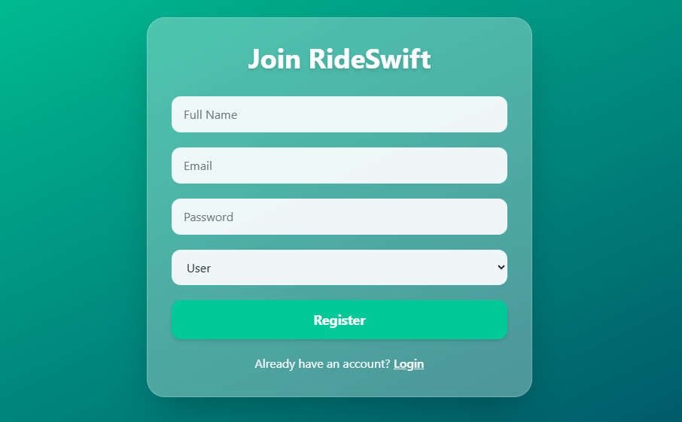
RideSwift: A Smart Ride-Sharing Platform
Implementation
Screen layouts
Fig. 1.1 : Register page

Slide 36
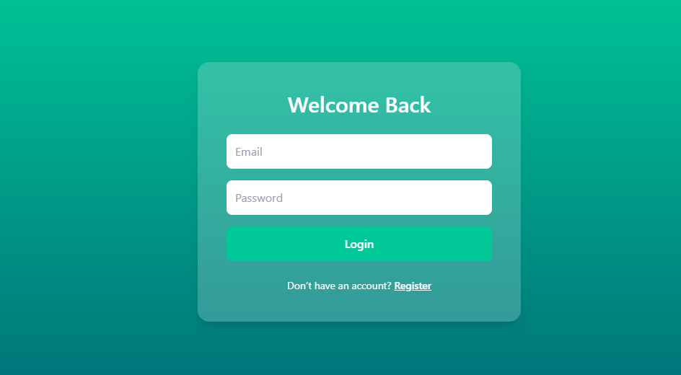
RideSwift: A Smart Ride-Sharing Platform
Implementation
Screen layouts
Fig. 1.2 : Login page

Slide 37
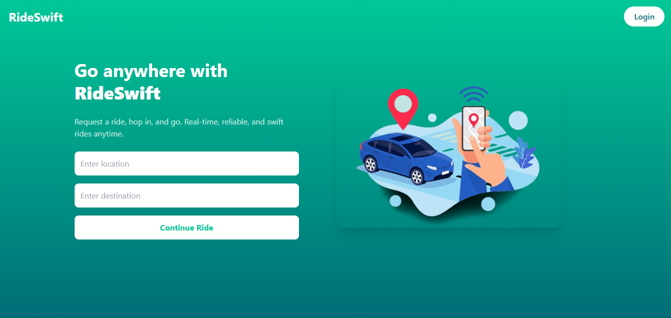
RideSwift: A Smart Ride-Sharing Platform
Implementation
Screen layouts
Fig. 1.3 : Home page

Slide 38
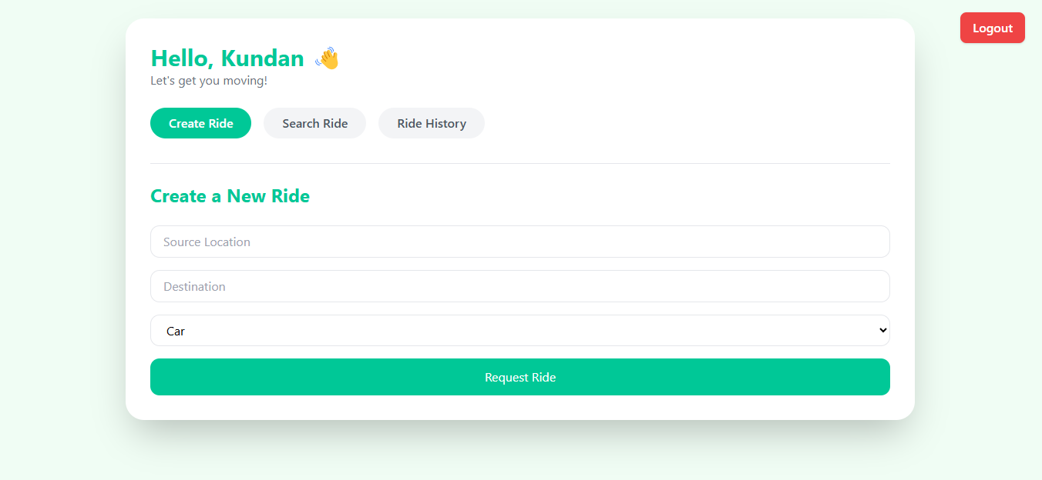
RideSwift: A Smart Ride-Sharing Platform
Implementation
Screen layouts
Fig. 1.4 : UserDashboard page

Slide 39
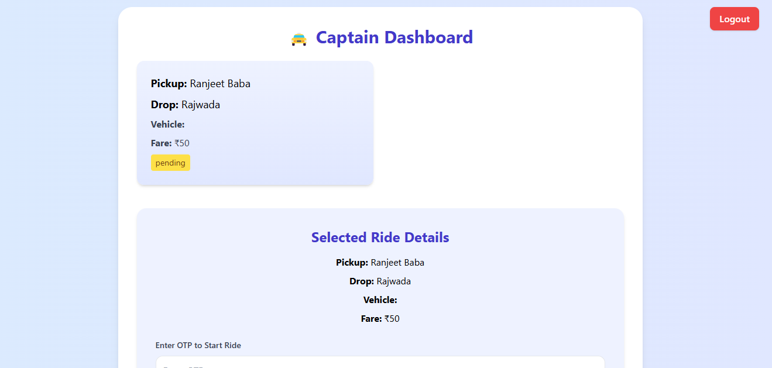
RideSwift: A Smart Ride-Sharing Platform
Implementation
Screen layouts
Fig. 1.5 : Captain Dashboard page

Slide 40
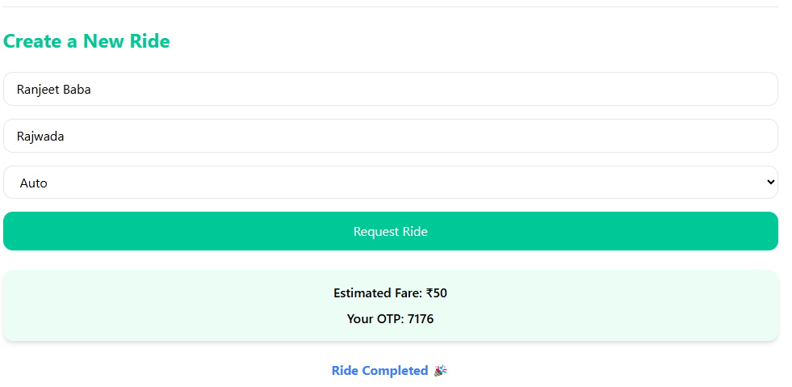
RideSwift: A Smart Ride-Sharing Platform
Implementation
Screen layouts
Fig. 1.6 : Ride page

Slide 41
RideSwift: A Smart Ride-Sharing Platform
Conclusions
Difficulties encountered during project
When the project is developing that time I have lack of information of Node.js that time I take help of online tutorials.
At the time of development analysis gives me problem how to start the project and from where place start the development.
Limitations of the system
Payment Gateway is not incorporated for users to pay publishing fee.
System works in all platforms.
Scope of Future Enhancements
Globalization of site
Addition of some more new categories may takes place.

Slide 42
RideSwift: A Smart Ride-Sharing Platform
Bibliography
Websites
“w3schools”, “JavaScript”, https://www.w3Schools.com
“geeksforgeeks”, “React.js”, https://www.geeksforgeeks.org/react-tutorial
“coder’s gyan”, “Node.js”, https://www.youtube.com/c/CodersGyan
“geekyshows”, “Express.js, mongoDB”, https://www.youtube.com/c/Geekyshows

